Slide 1
CO2 Methods of Injection

Slide 2
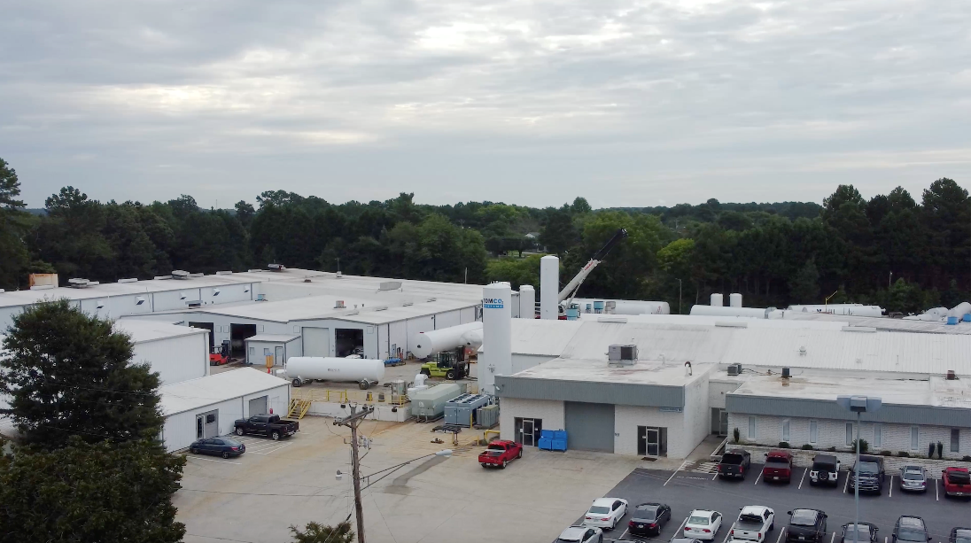
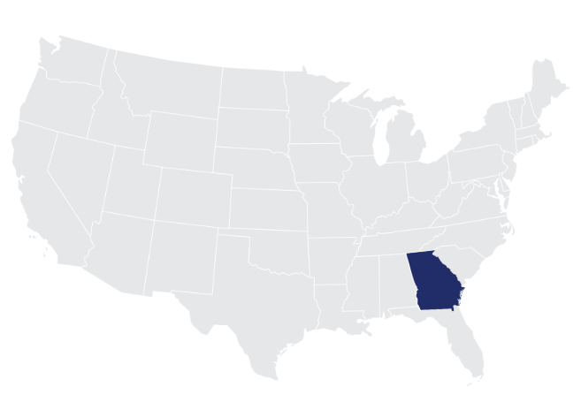
TOMCO Systems | General Overview
50+ Years in business
Located in Loganville, Georgia (metro Atlanta) since 1970
84,000 sq ft; 15+ acres
Recently acquired adjacent 2.75 acres for future expansion
Capable of Manufacturing Pressure Vessels up to 120-Tons
Certifications: ASME, ASME R, KGS, CE Mark, PED, CRN, FM, DOT, National Board of US
Highly experienced Management Team
Well diversified market segmentation for products and services
CO₂ Liquefaction, CO₂ ReGeneration & Dry Ice Production Equipment
Extensive Field Service and Technical Support infrastructure
Loganville, GA
6
CONFIDENTIAL
C H ANG I NG T H E W AY Y O U T HI NK ABO U T CO 2

Slide 3
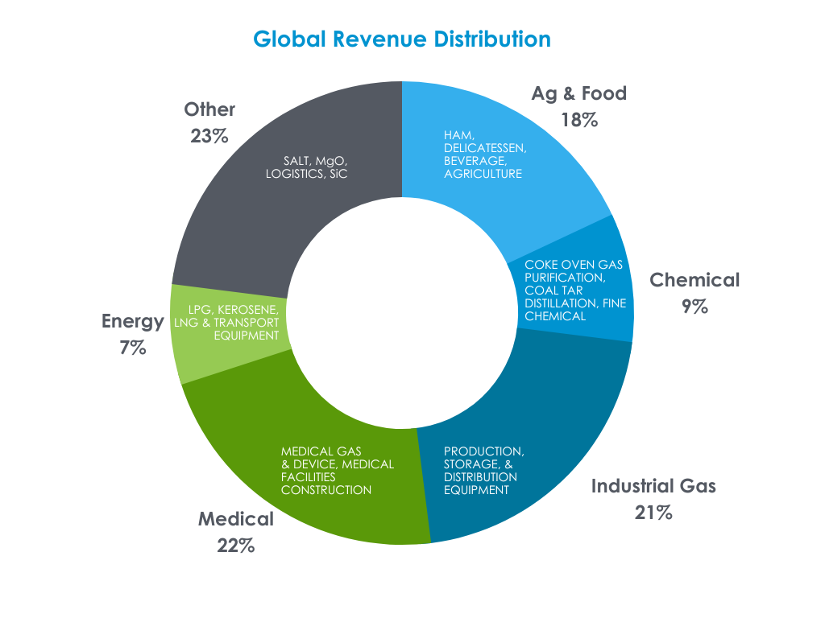
Air Water Inc. | About
Headquartered in Osaka, Japan with
~$8.9B in Annual Sales (95% in Japan)
18,000+ Employees
A Market Leader in Japan Industrial Gas & Cryogenic Equipment with
~$2B in sales
Focus on International Growth and Acquisitions
Manufacturing Companies with Engineered Industrial Gas Products
Gas Plants & Production
Acquire, Invest, Grow & Hold

Slide 4
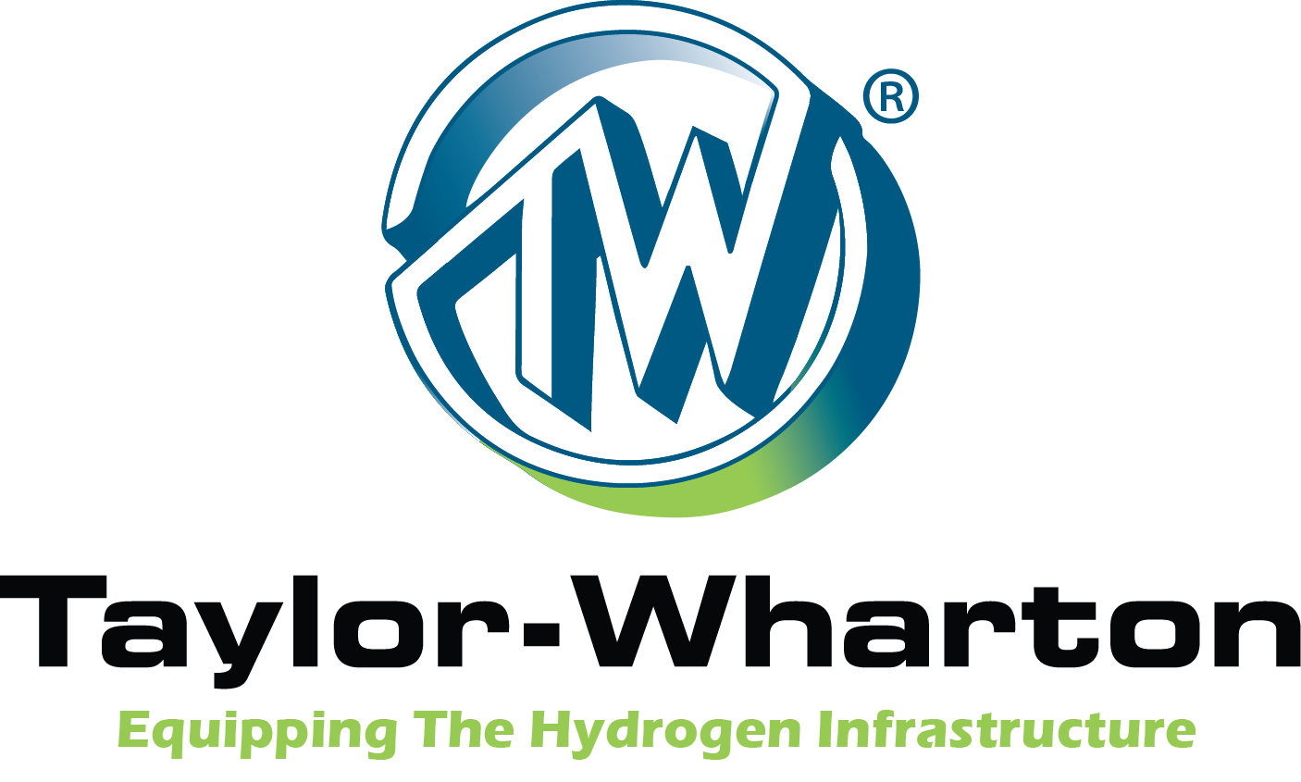
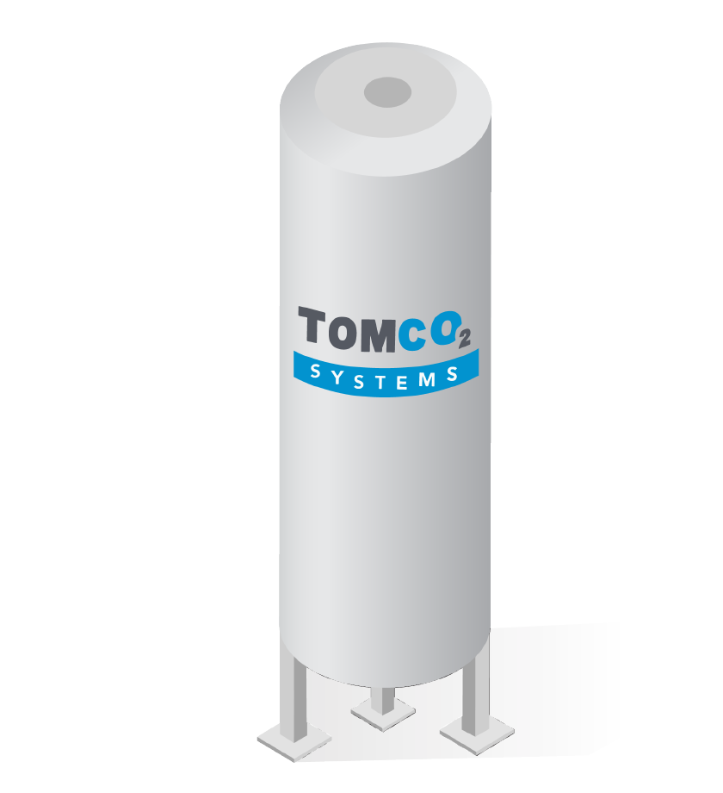
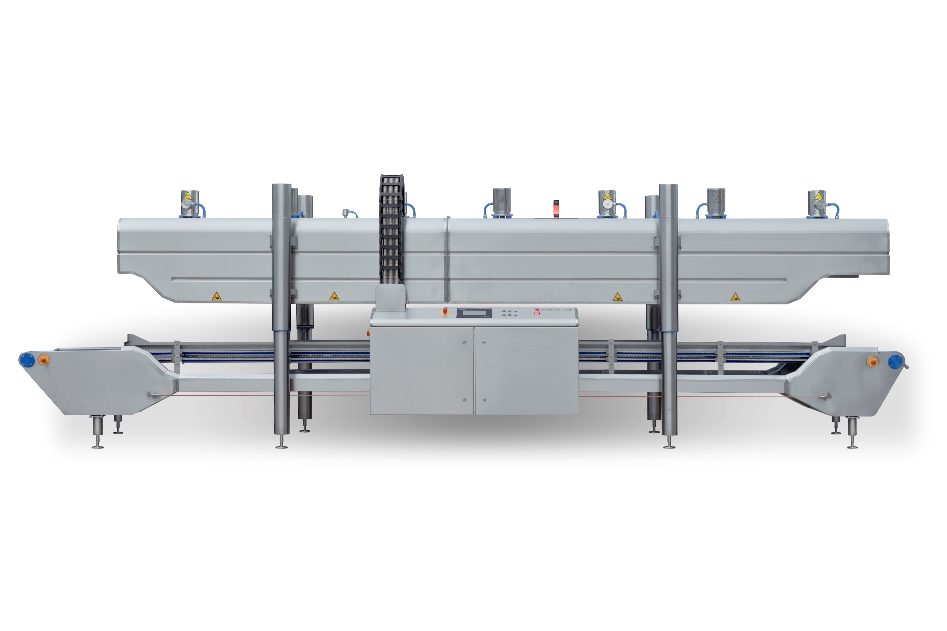
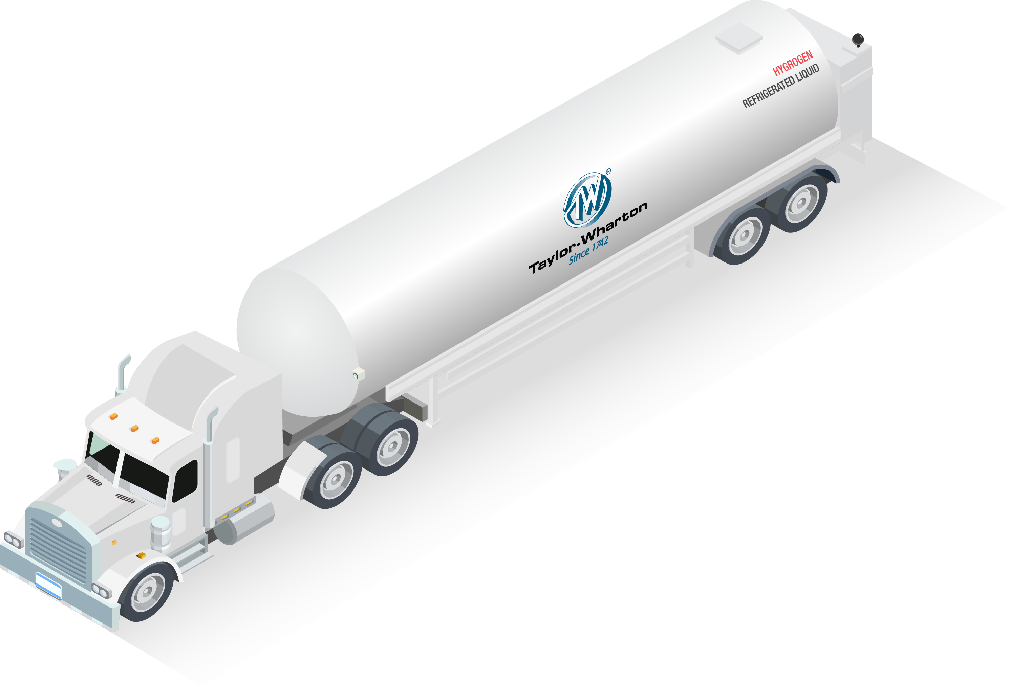
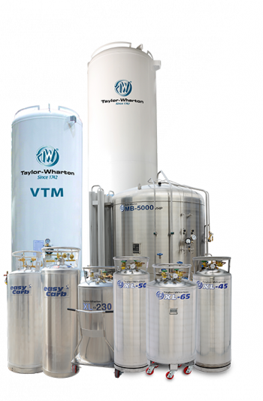
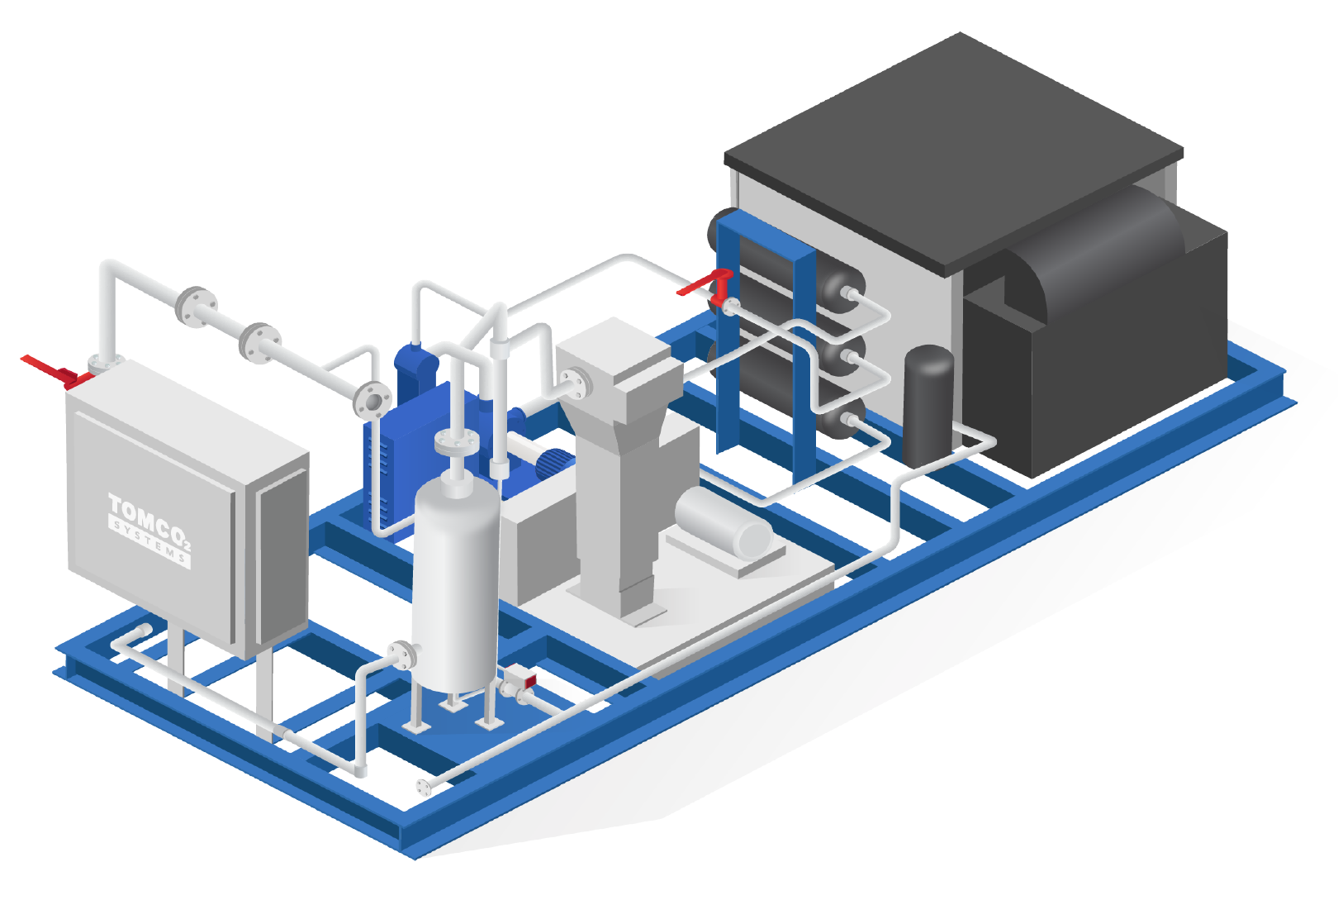
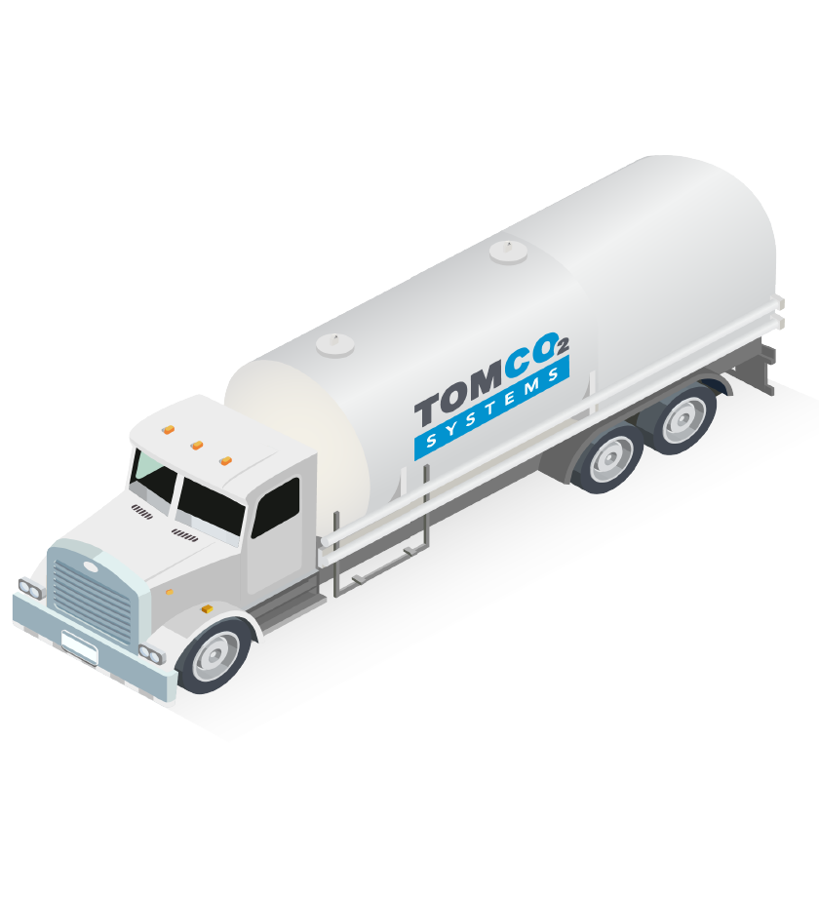
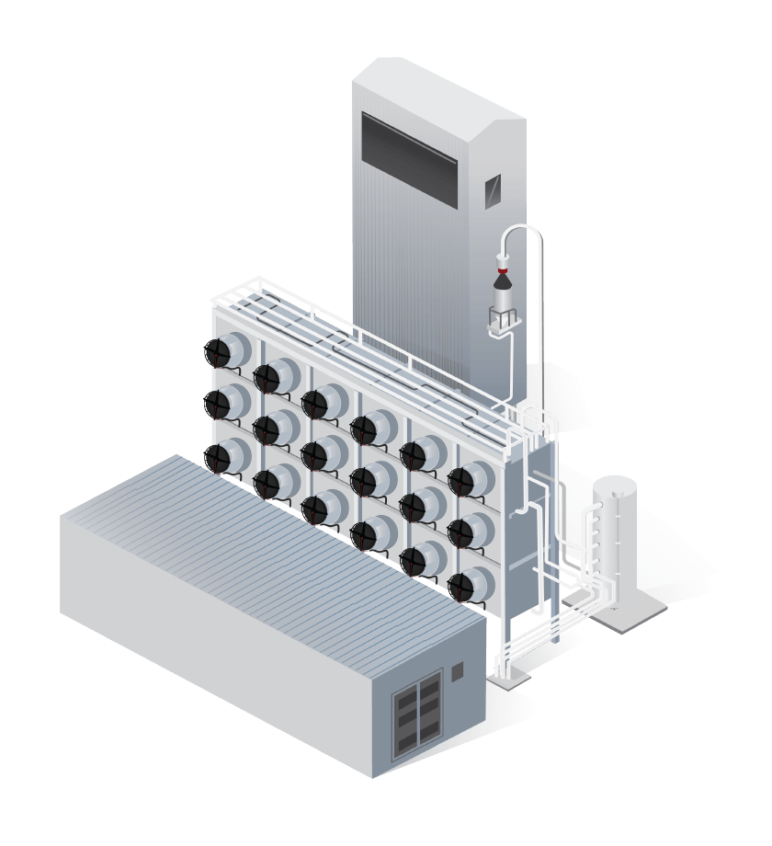
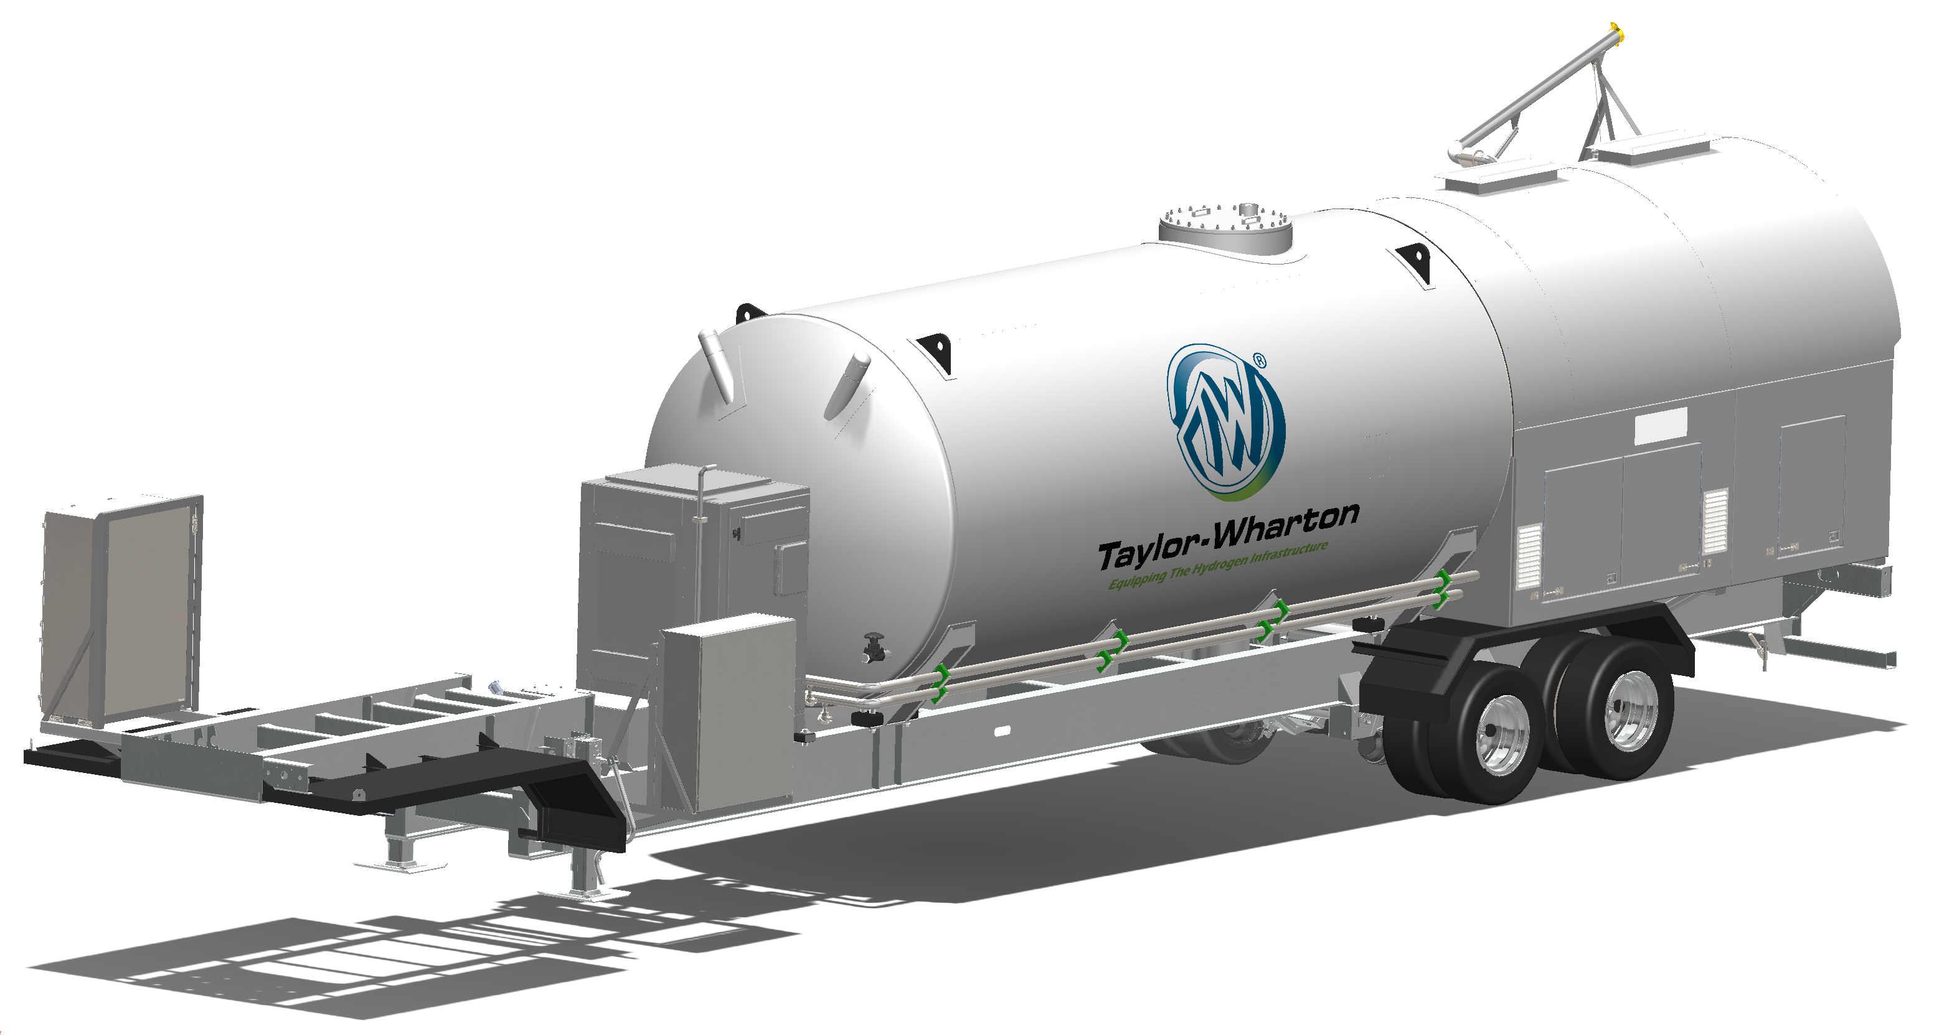
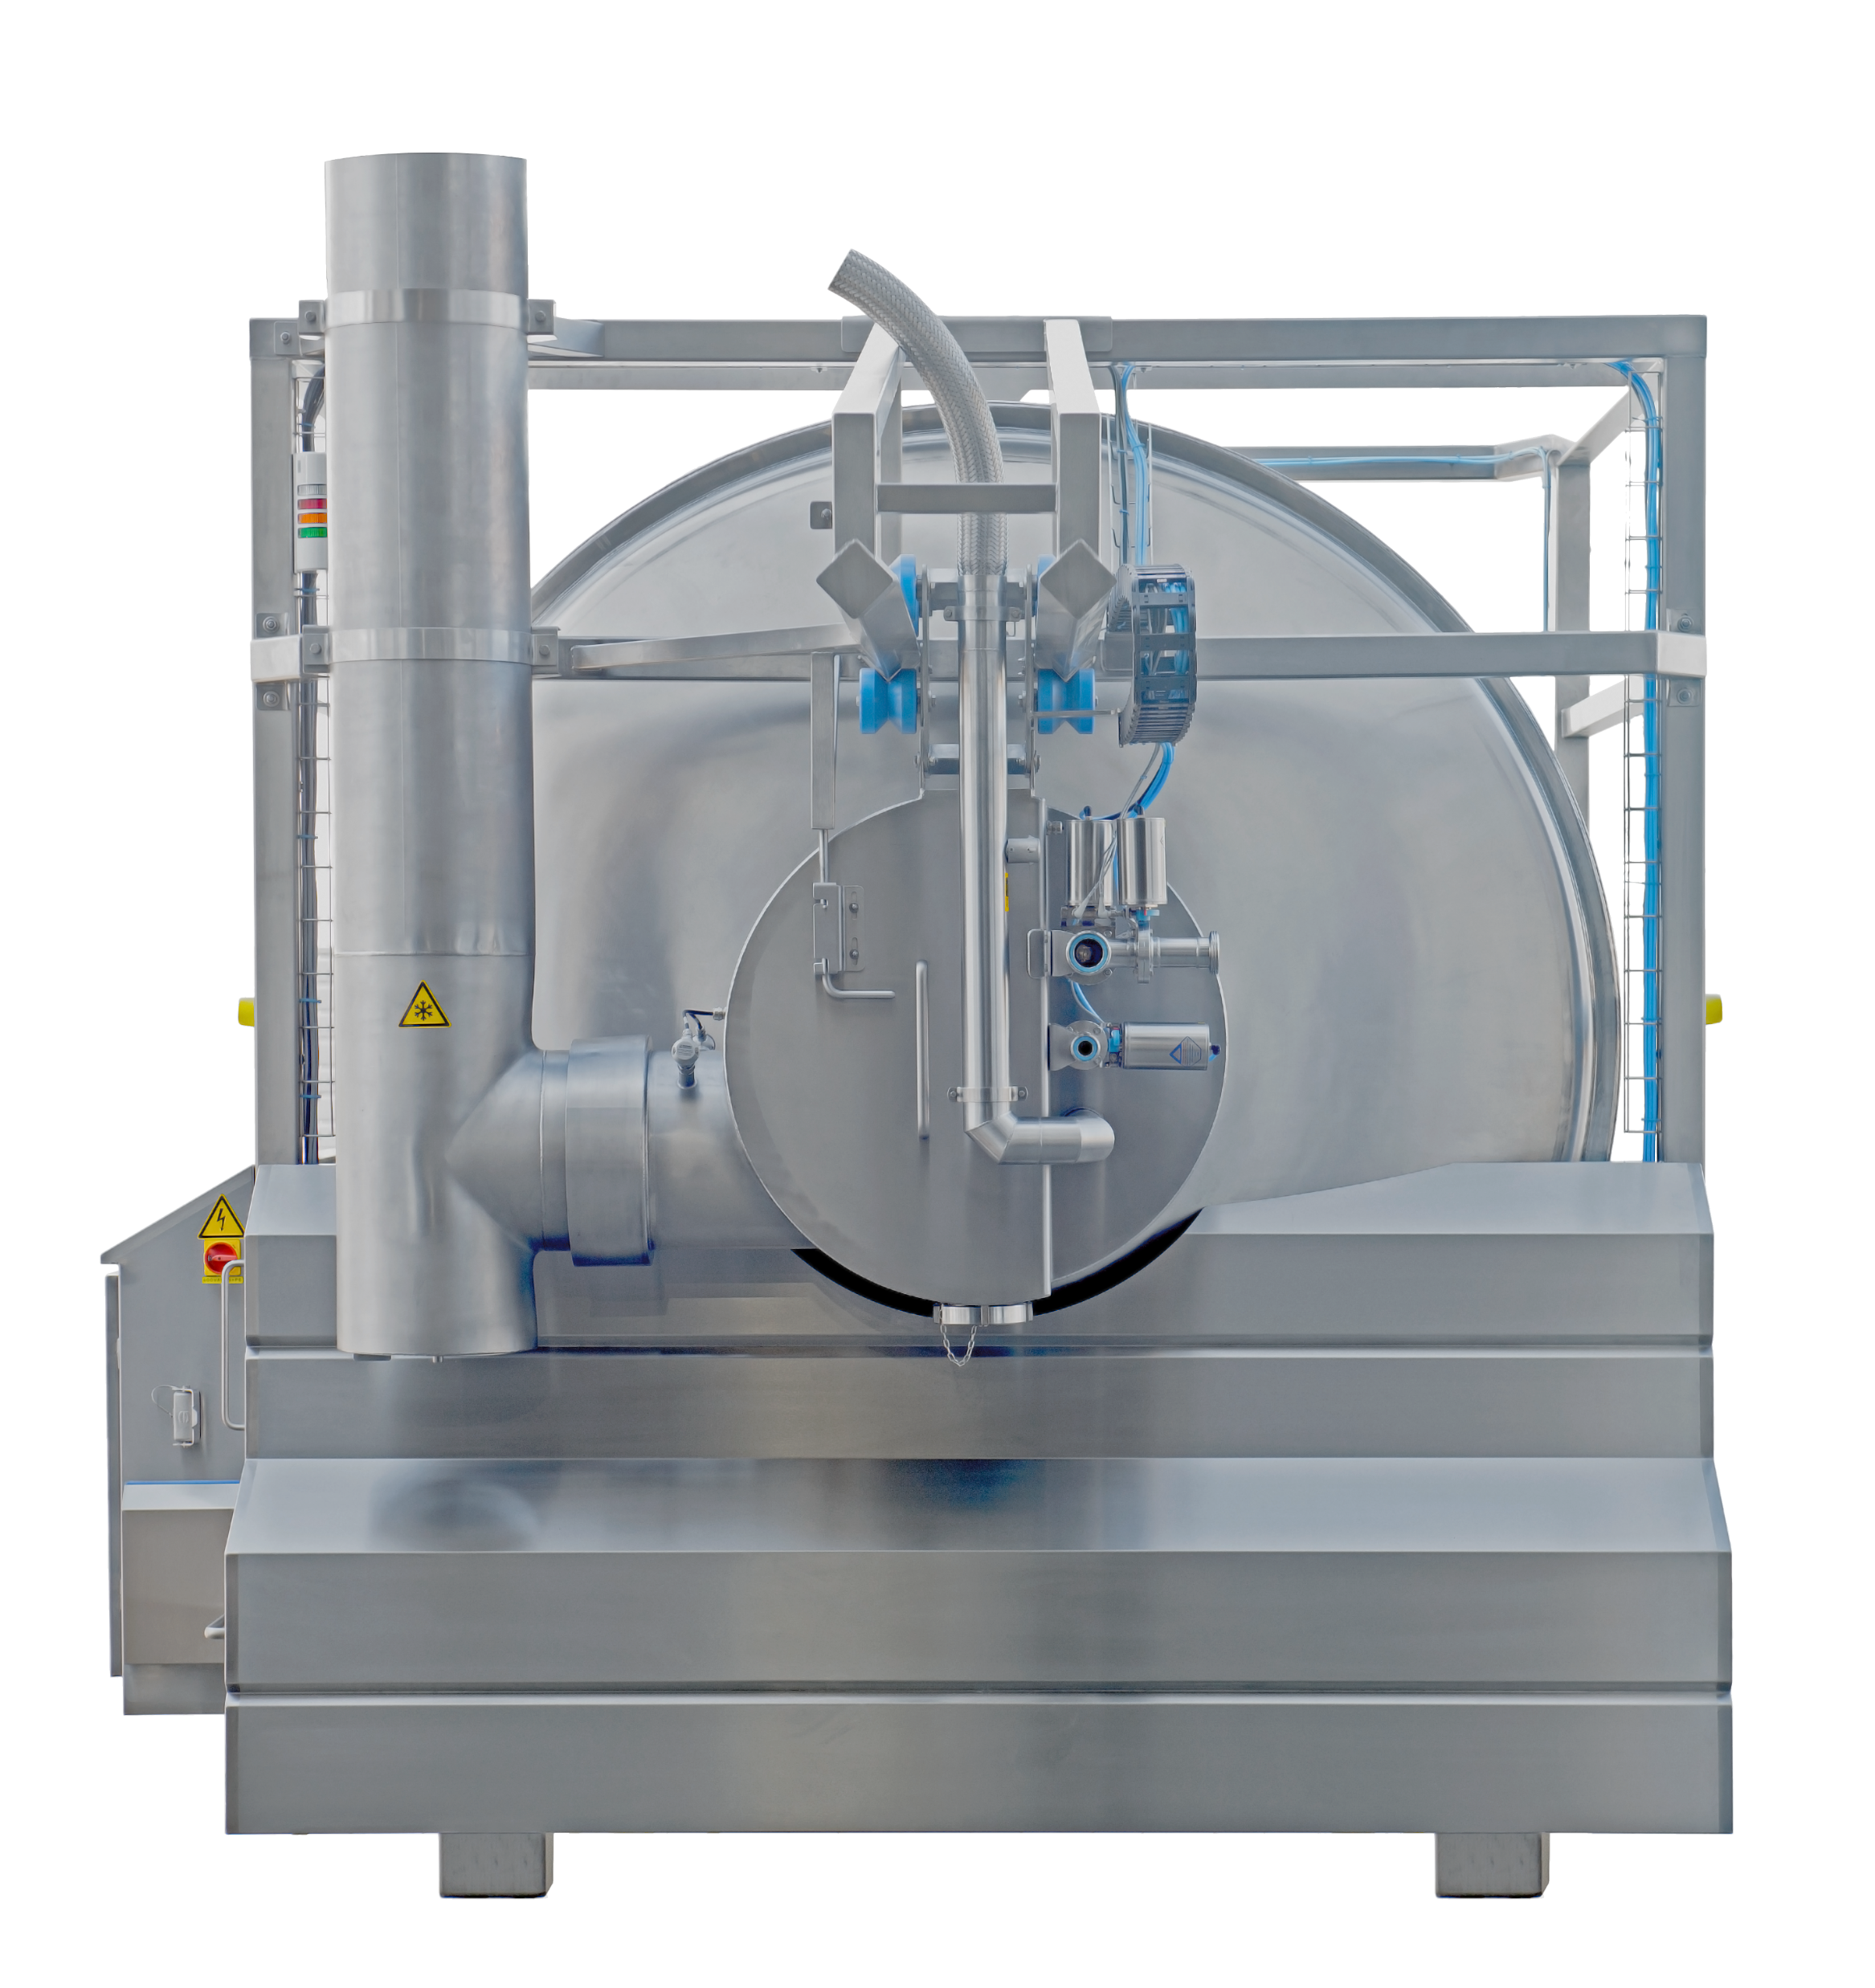
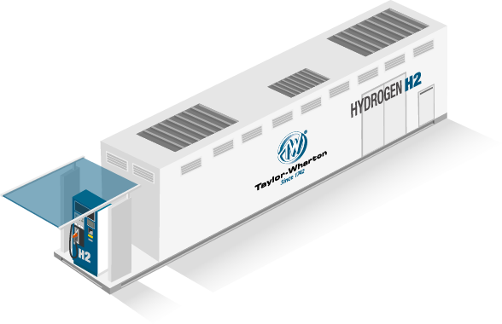
Gas & Engineering
Cryogenic Equipment
H2 Fuel Stations
AIR WATER GAS SOLUTIONS INC.
Cryogenic Freezer – CO2/LN2
-Tunnel Freezer
-Batch Freezer
-Spiral Freezer
-Tumbler
H2 Fuel Stations and Distribution
-$50M Investment
Public hydrogen stations
Largest station operator in California serving FCEV’s
Plant Engineering
-Air Separation Plant
-H2 Production/Liquefaction
-CO2 Purification/Liquefaction
Gas Production & Supply
-Plant Operation & Maintenance
-Industrial Gas Supply
(O2, N2, Ar, H2, CO2)
Gas Application
-Water Treatment System
-Fire Suppression System
-Dry Ice related equipment
Cryogenic Equipment
-CO2 delivery & storage
EPC
-CO2 Plants
Cryogenic Equipment – N2/H2/LNG
-Tanks & Cylinders
-Trailers
-ISO Containers
-Rail Cars
-HP Hydrogen Refuelers
-Vaporizer/VIP

Slide 5
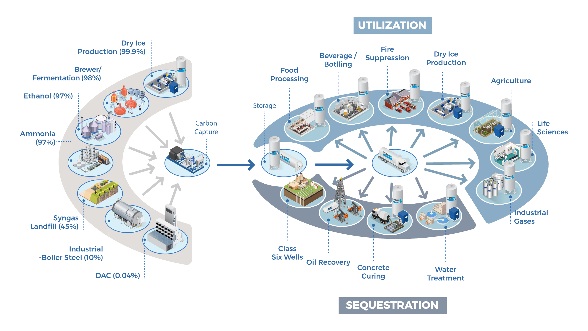
TOMCO Systems | General Overview
12

Slide 6
What is CO₂? How is it made?
Carbon Dioxide is a gas at normal atmospheric temperature and pressure.
Colorless, odorless gas that is about 1.5 times denser than air.
Dissolves in water to form carbonic acid; H₂CO₃. Carbon dioxide gas is formed from the combination of two elements: carbon and oxygen.
CO₂ is produced from the combustion of coal or hydrocarbons, the fermentation of alcohols, the production of anhydrous ammonia, by-product of other chemical processes, occur naturally in deep CO₂ wells and the breathing of humans and animals.
Found in small proportions in the atmosphere, it is assimilated by plants which in turn produce oxygen.

Slide 7
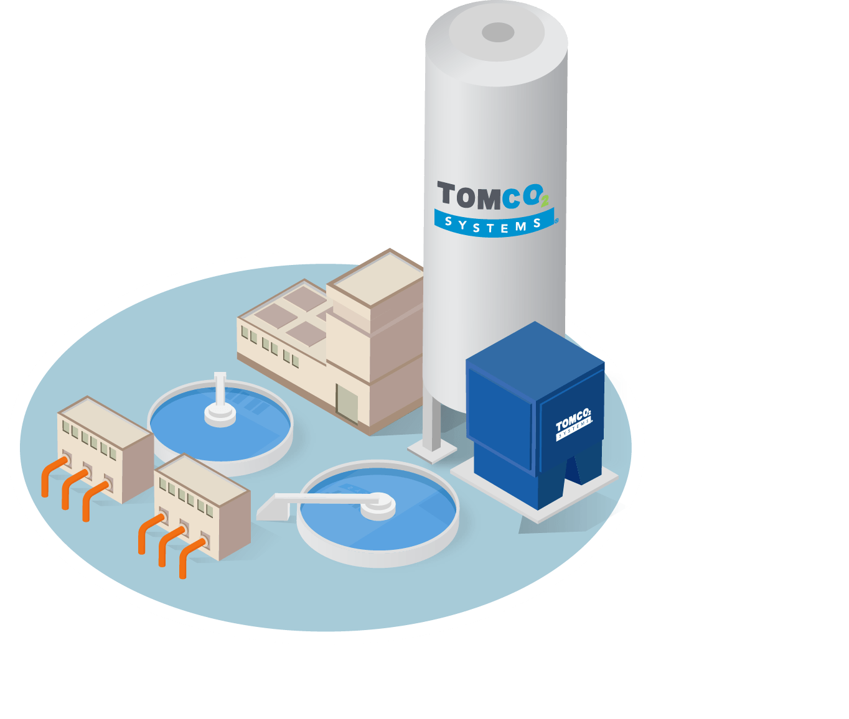
Adjusting pH | Why do we do it?
Stabilize Water Chemistry
Corrosion Control
Discharge Water (Permit)
Reduce or prevent Carbonate Scaling
Enhance chemical reaction or process
Polymers, Chlorine, Lime, Filtration, Contaminant removal

Slide 8
Carbon Dioxide pH Control Equipment
CO₂ Storage
Vaporizer
Vapor Heater
Pressure Regulator
CO₂ / H₂CO₃ Feed Panel
Diffuser

Slide 9
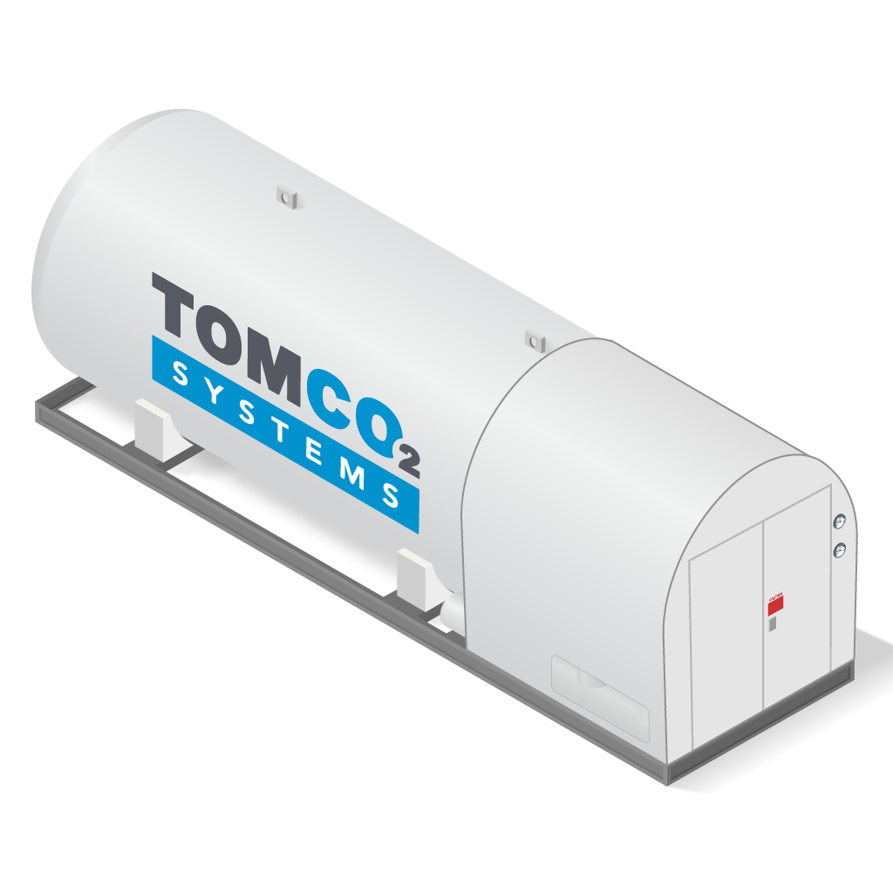
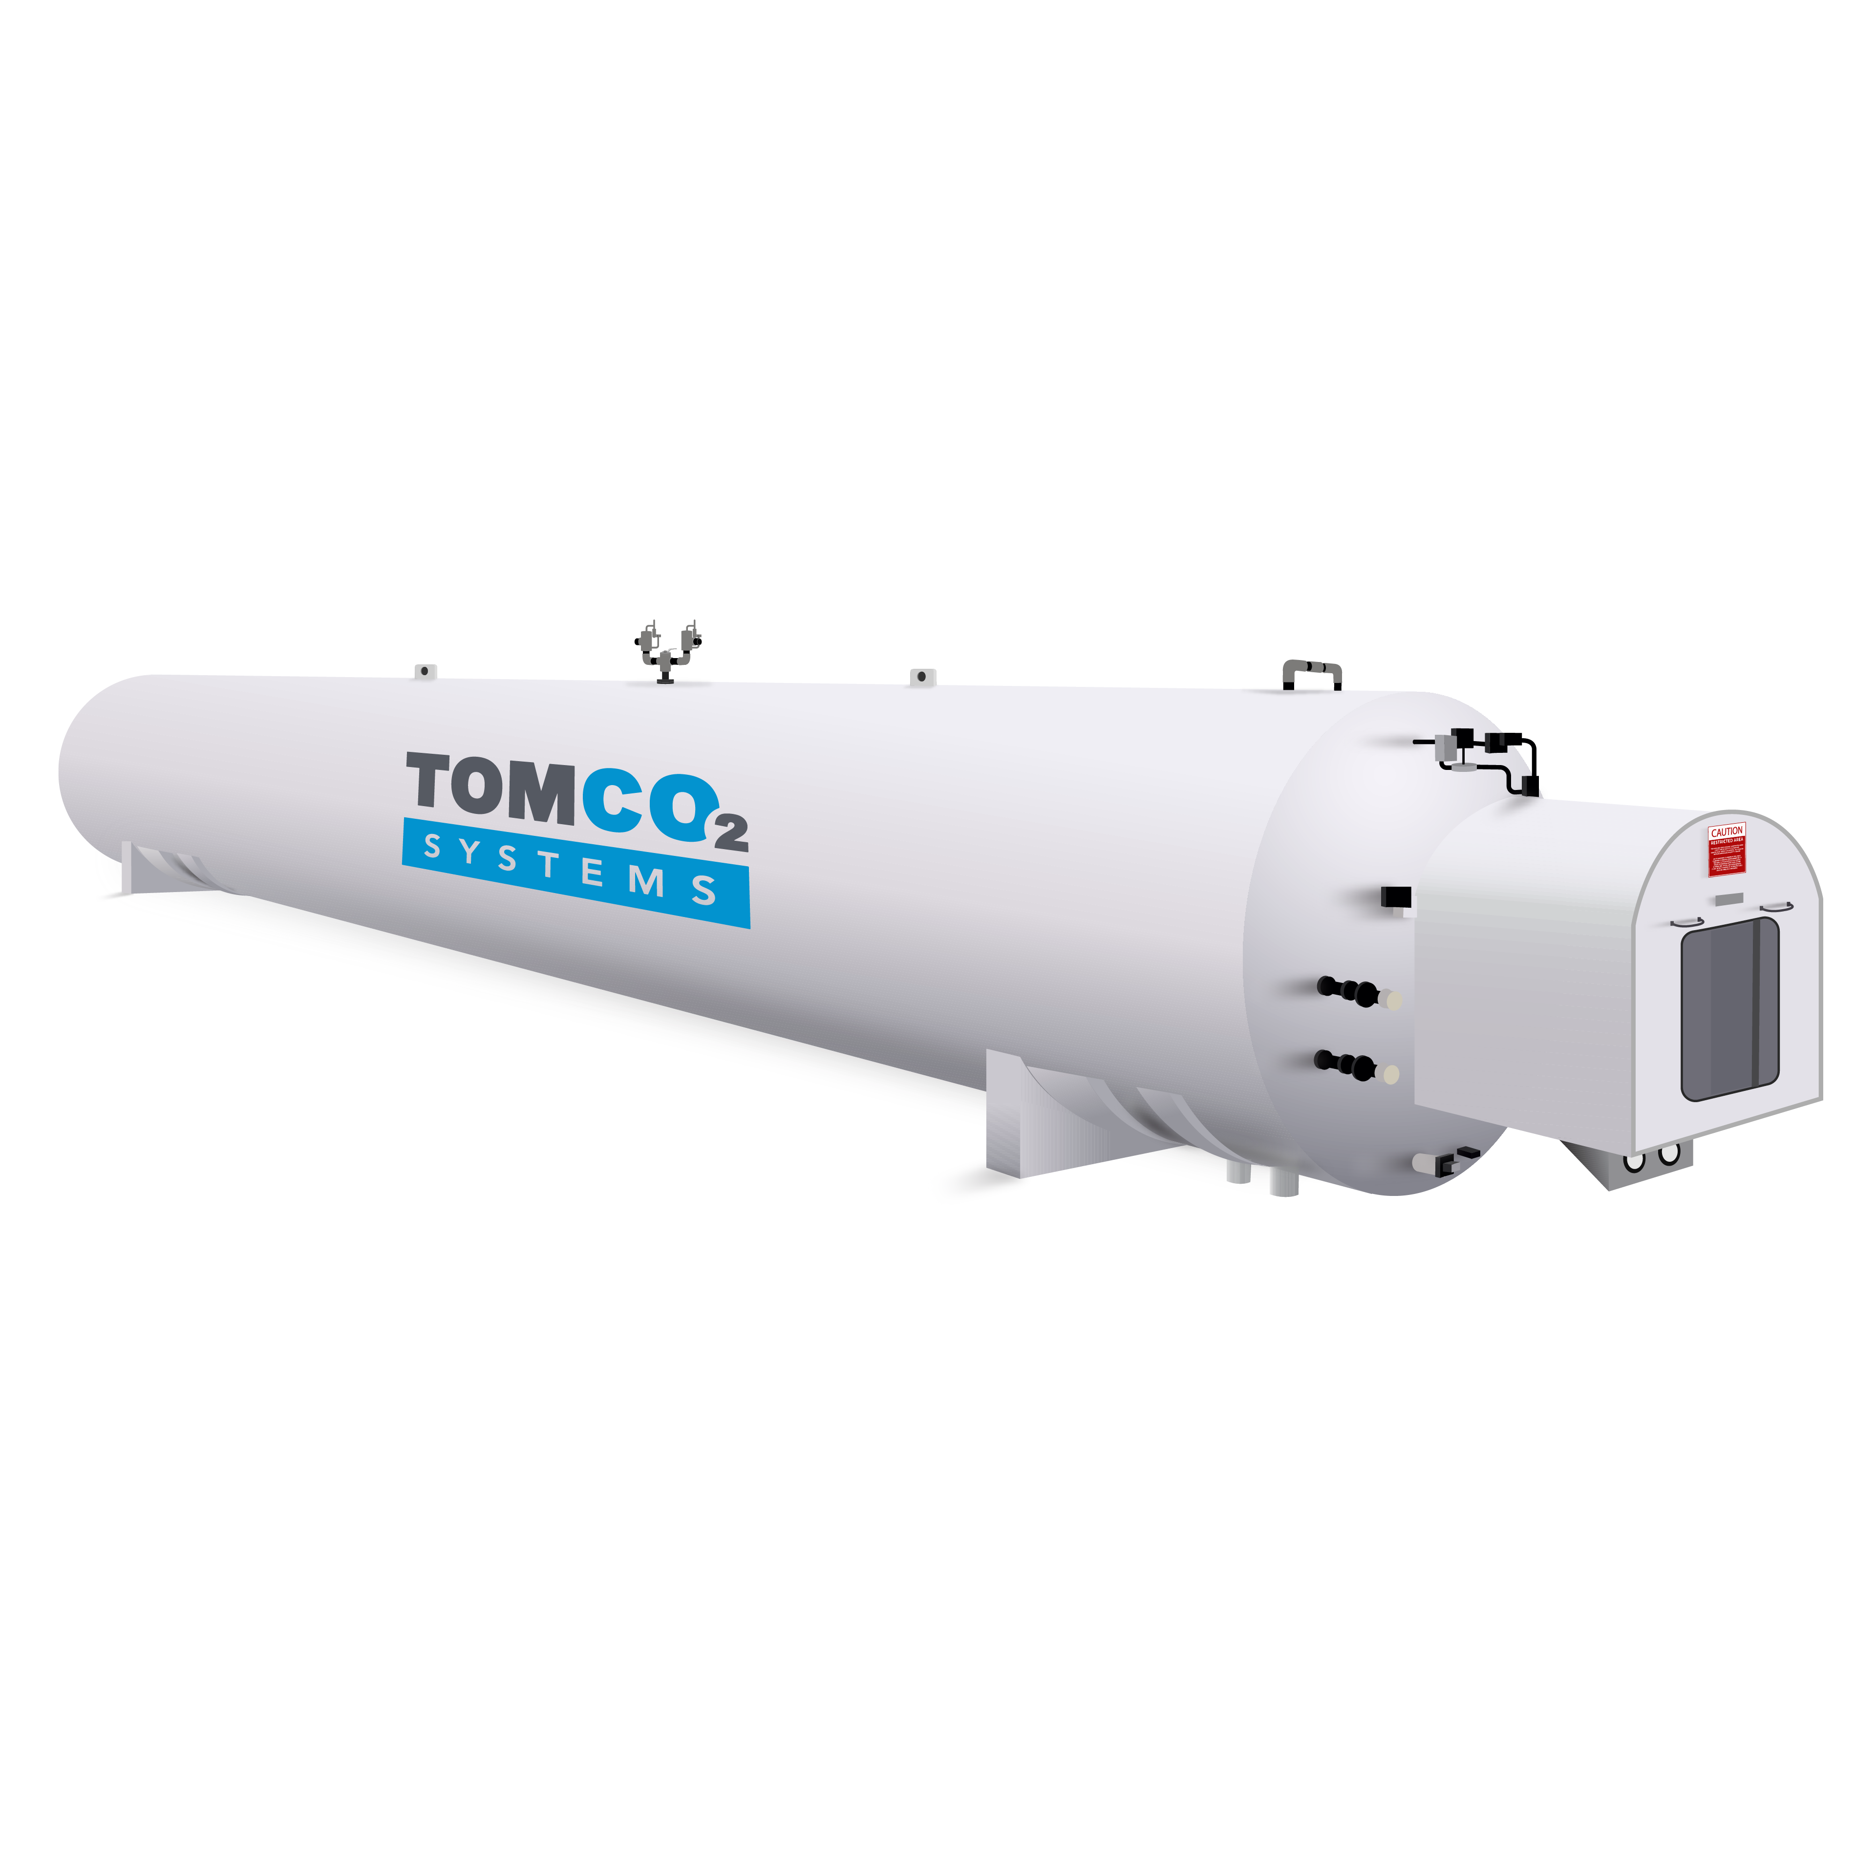
CO2 Bulk Storage
E/WTC-Style Series
3.75 Tons – 120 Tons Capacity
C-Style Series
3.75 Tons – 60 Tons Capacity
V-Style Series
6 Tons – 100 Tons Capacity

Slide 10
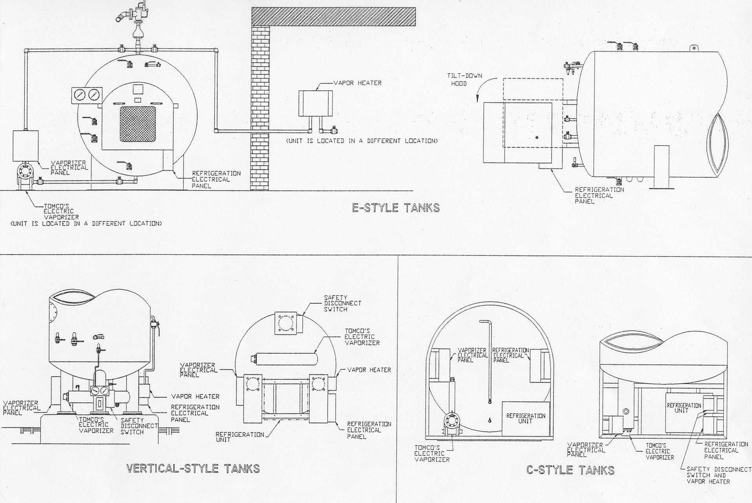
General Tank Layout

Slide 11
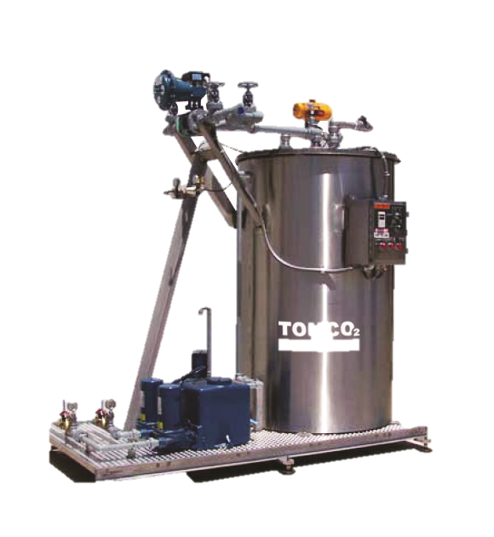
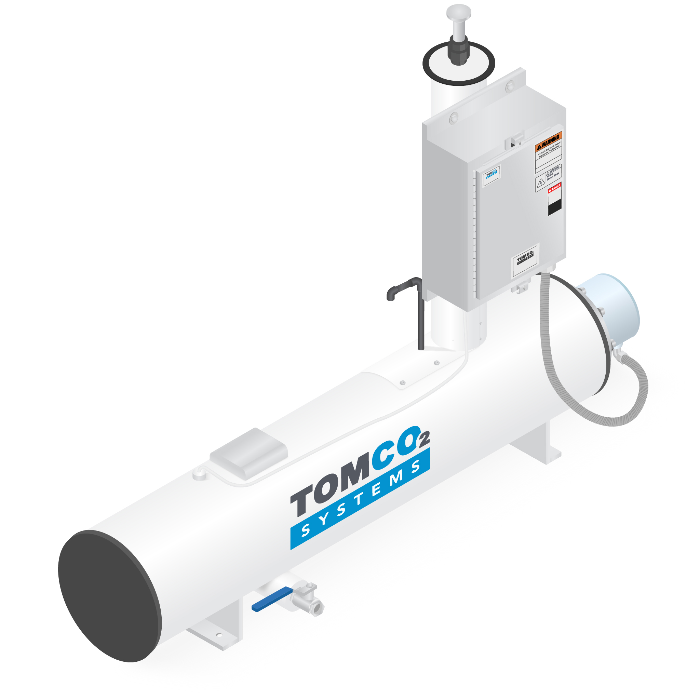
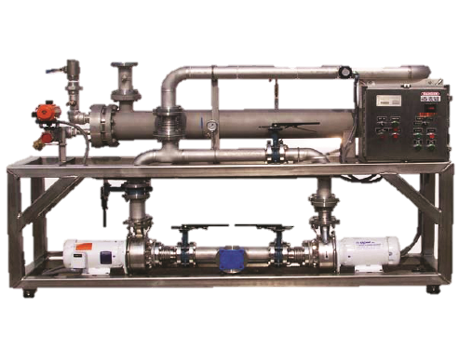
Products | CO2 Vaporizers
Variety of Vaporizers
Electric Pressure Build
245 lb/hr – 2150 lb/hr
Direct to Process
375 lb/hr – 2250 lb/hr
Steam
500 lb/hr – 18,000 lb/hr
Water
500 lb/hr – 20,000 lb/hr

Slide 12
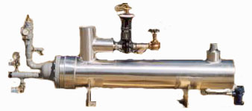
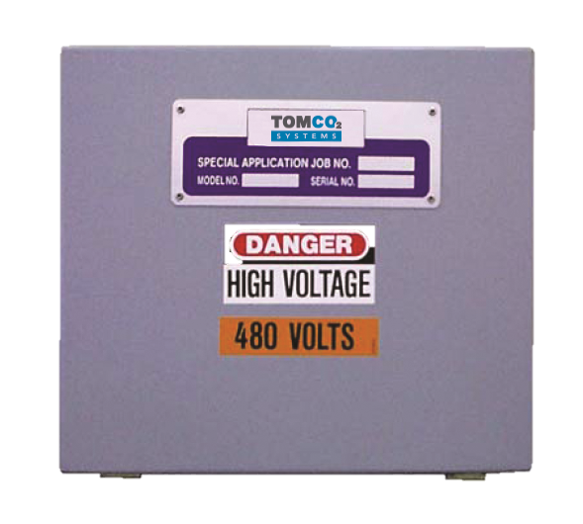
Products | CO2 Vapor Heaters
Electric
720 lb/hr to 1440 lb/hr (Wall)
2000 lb/hr to 6000 lb/hr (Floor)
Steam
500 lb/hr to 6,000 lb/hr

Slide 13
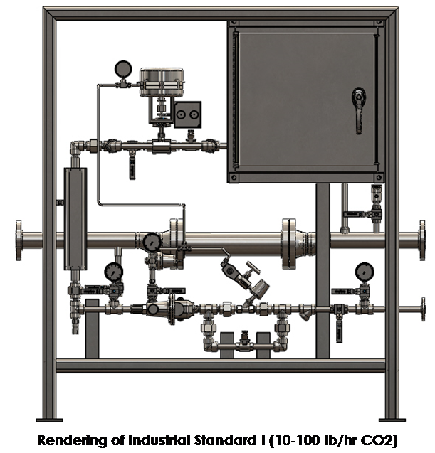
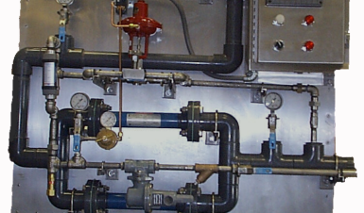
Products | CO2 Feed Equipment
CO₂ Gas Feed
60% - 85% efficiency of the
carbon dioxide
Needs deep contact or holding basins.
Able to reduce the pH to 7.0
Carbonic Acid (PSF)
Minimum 95% efficiency of the carbon dioxide
Able to reduce the pH to 5.5 – 6.0
Can be injected in a pipe, basin, tank or shallow channel.
Eliminates the need for deep contact or holding basins.

Slide 14
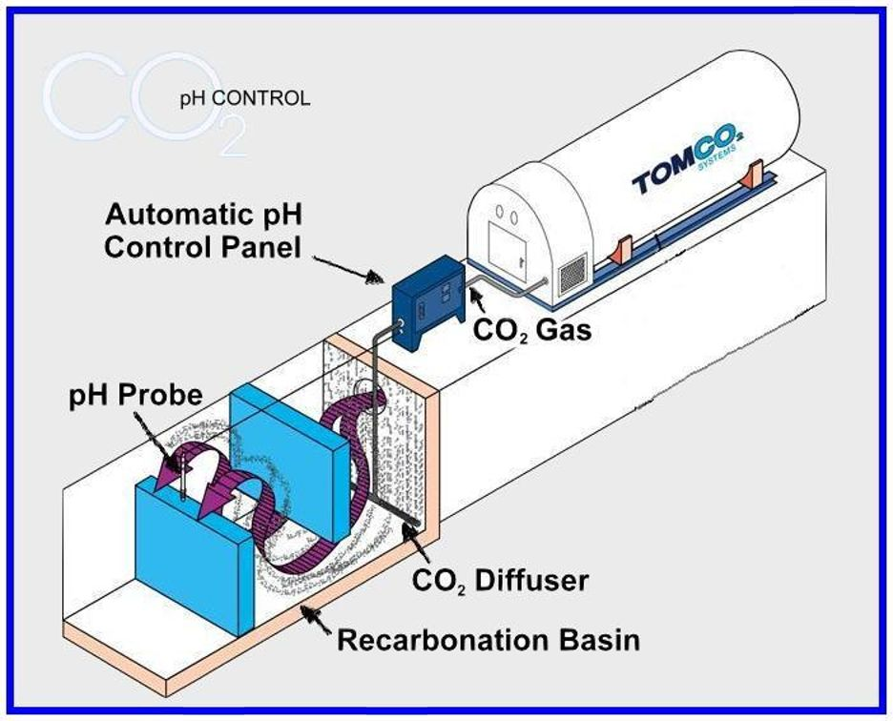
Products | CO2 Gas Injection
Gas (CO₂) + Liquid (water) reaction takes time
Requires tremendous surface area (fine bubbles)
Interference of other gases; i.e. air
Requires mixer or baffles to hold the gas down in the water
Lower efficiencies due to gas bubbles at the surface

Slide 15
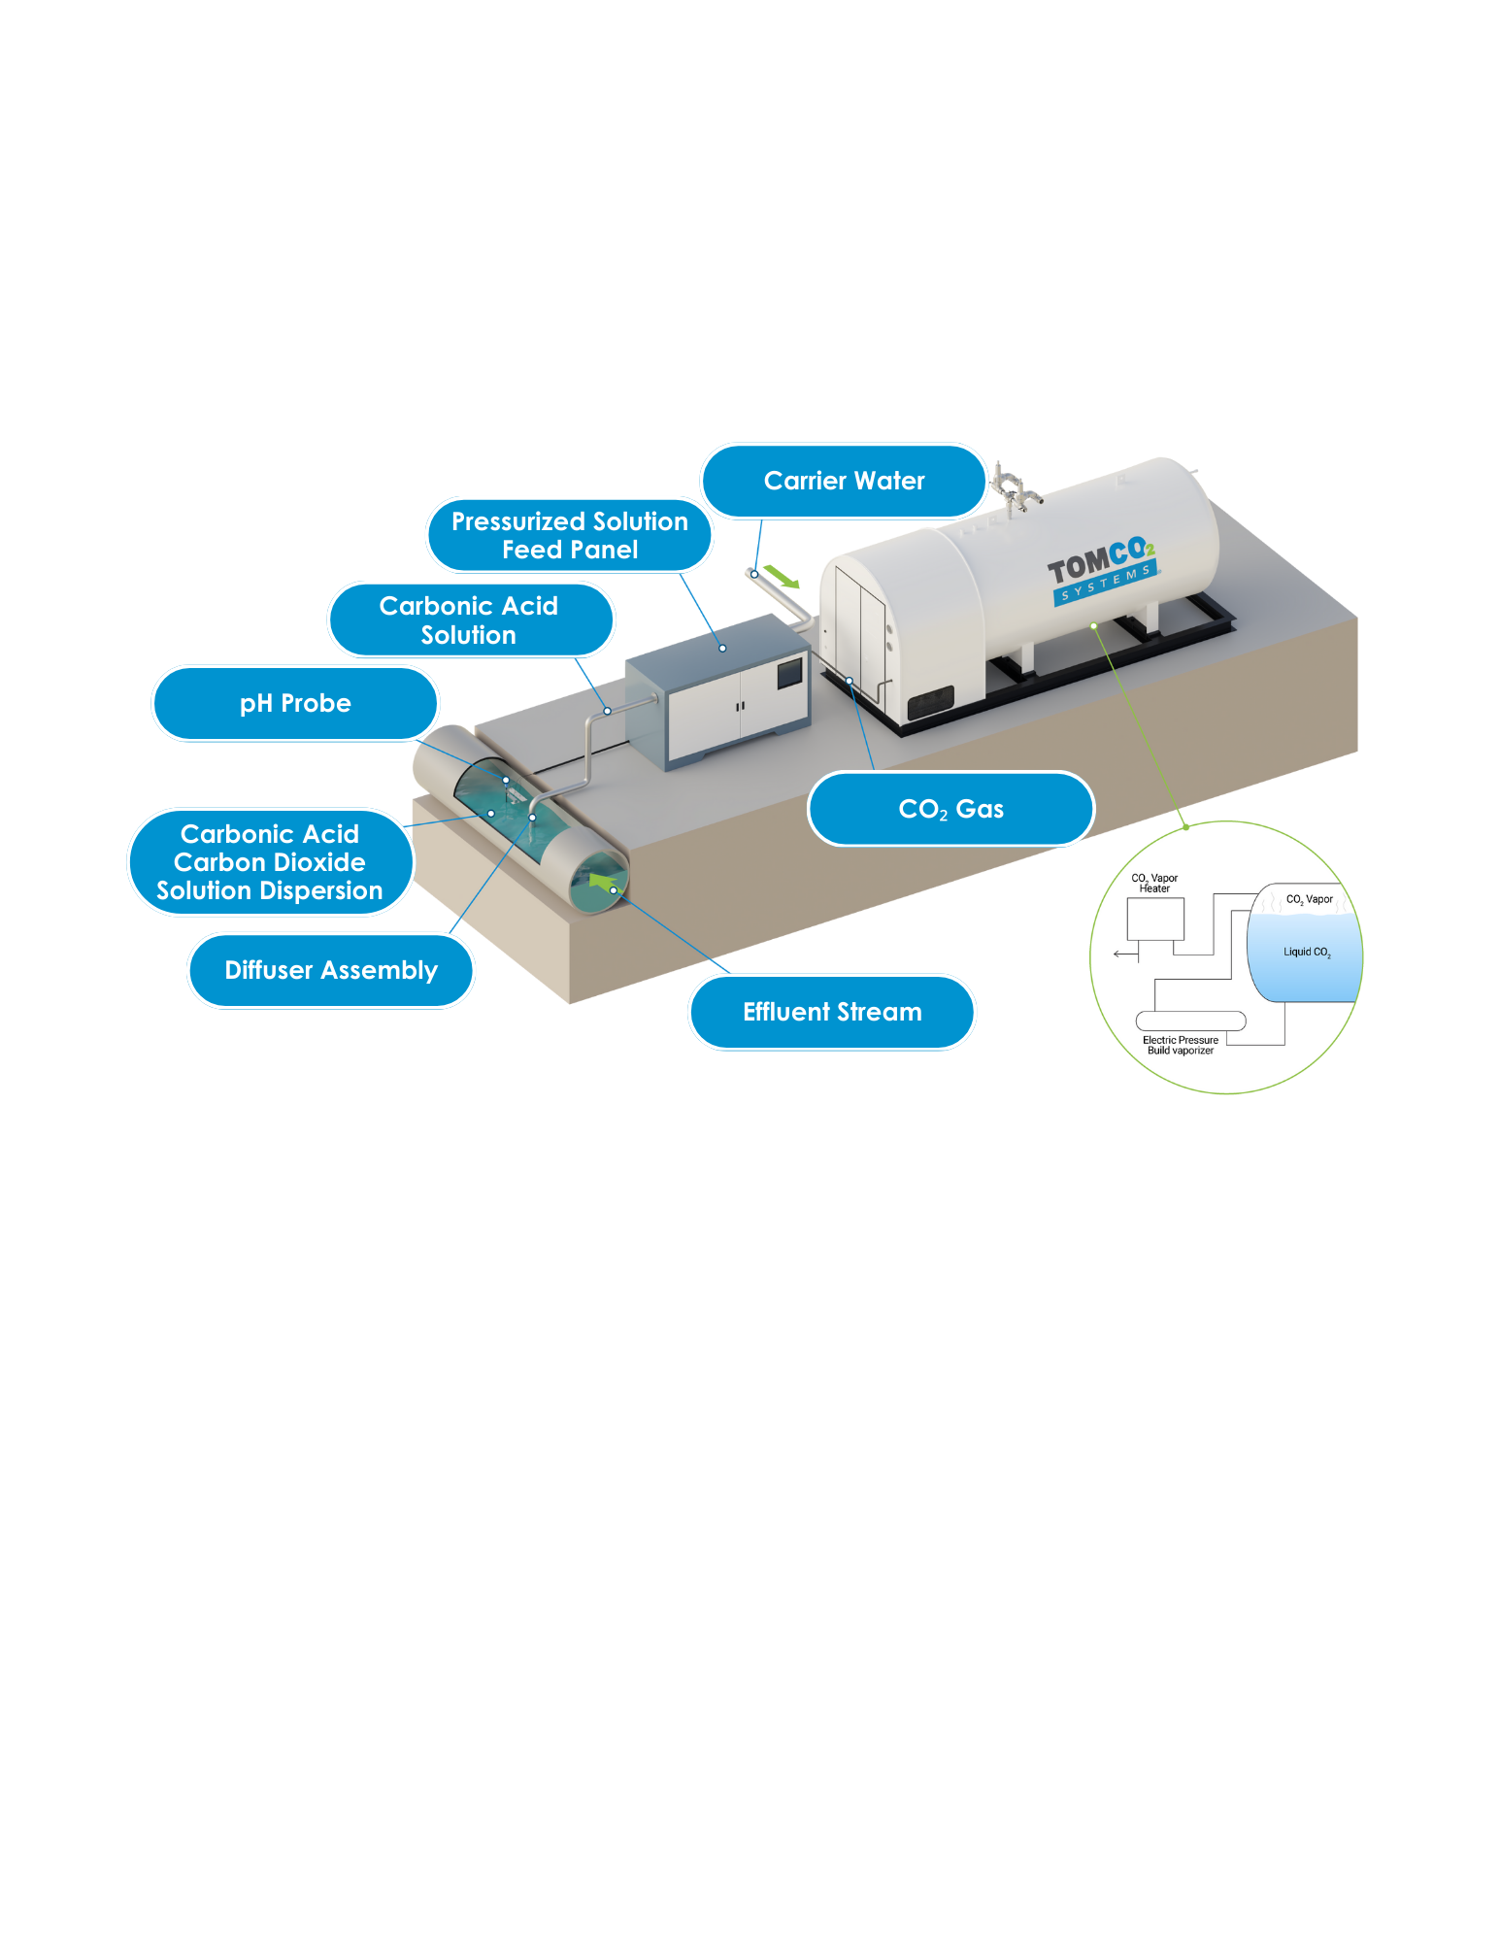
Products | Carbonic Acid Injection (PSF)
CO₂ pre-reacted to form Carbonic Acid
Liquid / Liquid (Carbonic Acid / Water) Reaction
Immediate reaction (Requires less time)
Close to 100% efficiency
Higher pressure improves CO₂ solubility
More effective pH control
Faster reaction time reduces scale potential.

Slide 16
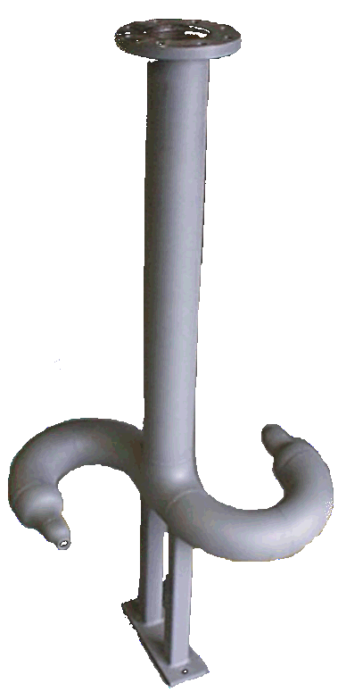
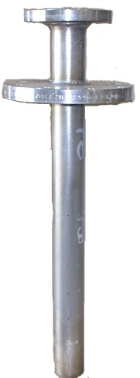
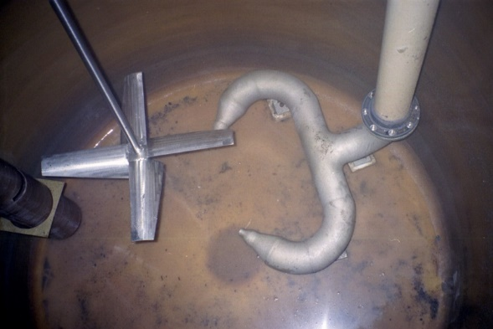
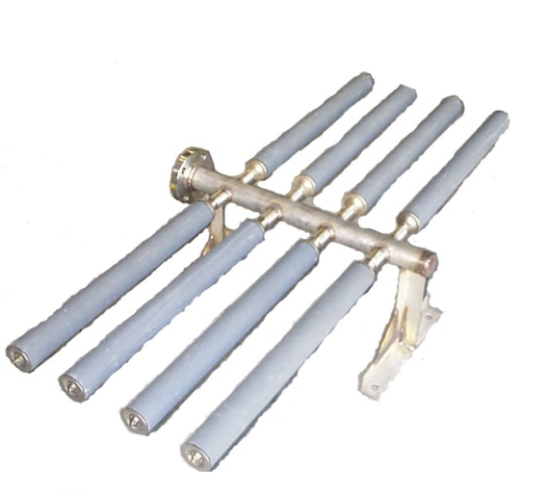
Products | CO2 Diffusers
Gas Feed
Uses fine porous diffuser to disperse the CO₂ into a deep basin.
Carbonic Acid
Disperses Carbonic Acid into a water stream to form the chemical reaction desired. Designed to fit in any situation

Slide 17
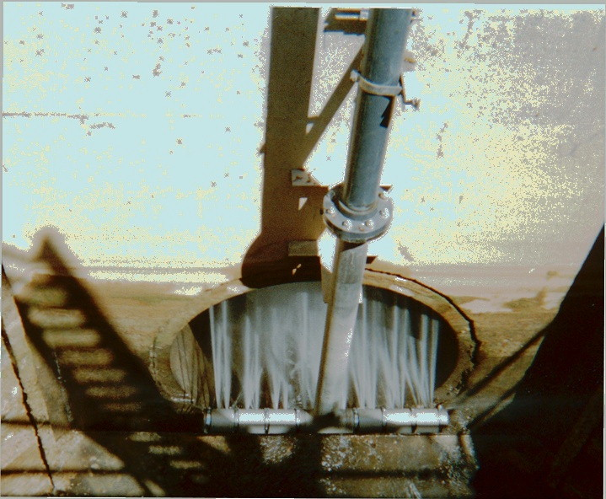
Products | Carbonic Acid Diffusers
Patent # 6637731 & 6767008
Counter Current
Cross Sectional Coverage
Pressure
Efficient Mixing
Immediate Reaction

Slide 18
Typical Flow Schematic

Slide 19
Why does TOMCO2 Use a 1:1 Ratio of Carrier Water to CO2?
At atmospheric conditions, we can dissolve 1 volume of CO2 into 1volume of water.
Soft drink companies increase that pressure to 60 psig, thereby, allowing 5x more the CO2 to be dissolved into your drink.
What happens when you open a coke can? You hear a fizz! The pressure drop that occurs causes the CO2 to off-gas due to supersaturation of the available liquid supply.
By using readily available carrier water in a 1:1 ratio of lb/hr CO2 to GPM carrier water, we adequately dissolve sufficient CO2 required for neutralization without offgassing.
While our competitor may claim that they use less carrier water than TOMCO2, they are super saturating their solution. The lack of carrier water leads to decreased efficiency when encountering a pressure drop. TOMCO2 ensures sufficient carrier water is used to maintain the CO2 in solution throughout the process.
The carrier water TOMCO2 requires is recycled through the system!

Slide 20
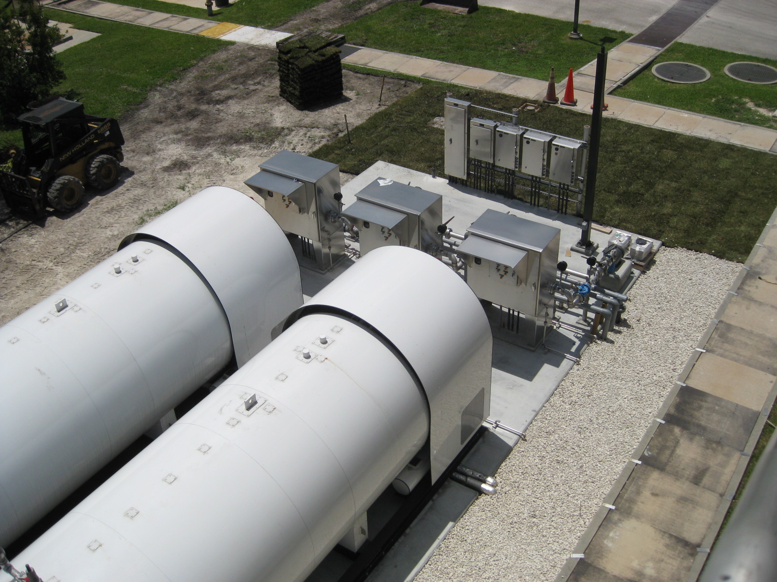
Areas to Use CO₂
Municipal Water Plants
Lime Softening
Enhanced Coagulation
Stripping – H2S
Corrosion Control
Membranes including RO
Disinfection – Sodium Hypochlorite
Filter Backwash
Bromate Reduction
Arsenic Removal
Chromium-6 Removal
Well Rehabilitation
Aquifer Storage & Recovery (ASR)
Ion Exchange Odor Control
Wastewater Discharge

Slide 21
Other Areas
Power Industry
pH Control for Ash Ponds
pH Control for wastewater and Boiler Blow Down water.
Scale reduction of cooling water
Steel & Chemical Industry
pH Control for Wastewater, Boiler blow down water.
Textile Industry
pH Control for Wastewater.
Concrete & Mining Industry
pH Control for Wastewater.
pH Control for Storm water Run Off.
Food and Beverage Industry
Carbonation
Formation of Hypochlorous Acid For Bacteria Kill
pH Control for Wastewater.

Slide 22
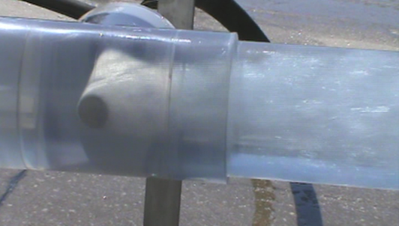
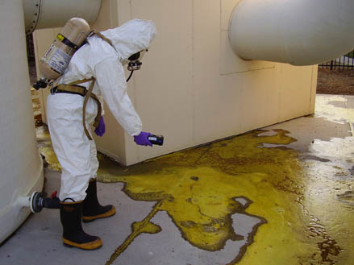
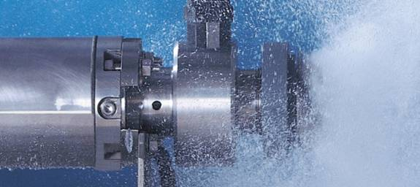
Other pH Control Methods
Liquid CO₂ Feed Systems
Gas Eductor / Vacuum Feeder
Chlorinator / Solution Feeder
Carbonated Water Feeder
Mineral Acids

Slide 23
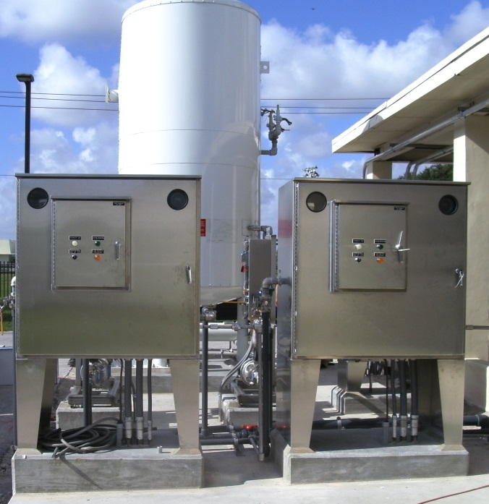
Manufacturer’s Qualifications
Experience in CO2 and Water Treatment Systems
Over 1,700 systems installed
Active member of CGA
Engineering Capability
Optimized pH control and CO2 utilization
Total System Responsibility
ASME Pressure Vessel shop
Service Capability
Made in the USA- Loganville, GA

Slide 24
Water Technologies
Camila Cando
Sales Application Engineer
ccando@tomcosystems.com
(c): 678-326-347
www.tomcosystems.com

